Slide 1

For All Your Gaming Needs

Slide 2
G
A
M
I
N
G

Slide 3

E
Q u
I
P m
E n
T

Slide 4


S
E
R
V
I
C
E

Slide 5

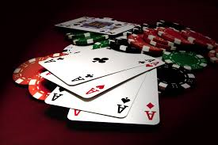


Always a Winner

